Slide 1
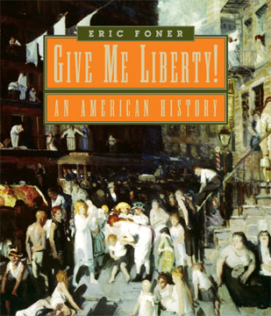
Chapter 6
Norton Media Library
Chapter 6
The Revolution
Within
Eric Foner

Slide 2
I. Abigail Adams

Slide 3
II. Democratizing Freedom
The Dream of Equality
  The Revolution unleashed public debates and political and social struggles that enlarged the scope of freedom and challenged inherited structures of power within America
    Rejected was the principle of hereditary aristocracy
  Inequality had been fundamental to the colonial social order
    The Declaration of Independence’s assertion that “all men are created equal” radically altered society

Slide 4
II. Democratizing Freedom (con’t)
Expanding the Political Nation
  The leaders of the Revolution had not intended this disruption of social order
  The democratization of freedom was dramatic for free men
  Artisans, small farmers, laborers, and the militia all emerged as a self-conscious element in politics
  The prewar elite of Pennsylvania opposed independence
    This left a vacuum of political leadership filled by Paine, Rush, Matlack, and Young
  Pennsylvania’s radicals attacked property qualifications for voting

Slide 5
II. Democratizing Freedom (con’t)
The New Constitutions
  All states wrote a new constitution and agreed that their governments must be republics
  States disagreed as to how the government should be structured
    Pennsylvania’s one-house legislature
    John Adams’s “balanced governments” of two-house legislatures

Slide 6
II. Democratizing Freedom (con’t)
The Right to Vote
  The property qualification for suffrage was hotly debated
  The least democratization occurred in the southern states whose highly deferential political traditions enabled the landed gentry to retain their control of political affairs
  By the 1780s with the exceptions of Virginia, Maryland, and New York, a large majority of the adult white male population could meet voting requirements
  Freedom and an individual’s right to vote had become interchangeable

Slide 7
III. Toward Religious Liberty
Separating Church and State
  The drive to separate church and state brought together Deists with members of evangelical sects
  The seven state constitutions that began with declarations of rights all declared a commitment to “the free exercise of religion”
  Many states still had limitations on religious freedom
  Thomas Jefferson’s “Bill for Establishing Religious Freedom” separated church and state
  James Madison insisted that one reason for the complete separation of church and state was to reinforce the principle that the new nation offered “asylum to the persecuted and oppressed of every nation and religion”

Slide 8
III. Toward Religious Liberty (con’t)
The Revolution and the Churches
  As religious liberty expanded some church authority was undermined
    Moravian Brethren
  Thanks to religious freedom, the early republic witnessed an amazing proliferation of religious denominations
A Virtuous Citizenry
  Despite a separation of church and state, public authority continued to support religious values
  Leaders wished to encourage virtue—the ability to sacrifice self-interest for the public good

Slide 9
IV. Defining Economic Freedom
Toward Free Labor
  The lack of freedom inherent in apprenticeship and servitude increasingly came to be seen as incompatible with republican citizenship
    Ebenezer Fox
  By 1800, indentured servitude had all but disappeared from the United States
    The distinction between freedom and slavery sharpened

Slide 10
IV. Defining Economic Freedom (con’t)
The Soul of a Republic
  Equality was the very soul of a republic
  To most free Americans “equality” meant equal opportunity, rather than equality of condition
  Thomas Jefferson, and others, equated land and economic resources with freedom
The Politics of Inflation
  The war produced inflation and some Americans took matters into their own hands

Slide 11
IV. Defining Economic Freedom (con’t)
The Debate over Free Trade
  Congress urged states to adopt measures to fix wages and prices
  Smith’s argument that the “invisible hand” of the free market directed economic life more effectively and fairly than governmental intervention offered intellectual justification for those who believed that the economy should be left to regulate itself

Slide 12
V. The Limits of Liberty
Colonial Loyalists
  Loyalists remained loyal to the crown
    Estimated 20 to 25 percent of Americans were Loyalists
  Some Loyalists ethnic minorities feared that local majorities would infringe on their freedom to enjoy cultural autonomy

Slide 13
V. The Limits of Liberty (con’t)
The Loyalists’ Plight
  The War for Independence was in some respects a civil war among Americans
  War brought a deprivation of basic rights to many Americans
    Many states required residents to take oaths of allegiance to the new nation
  When the war ended, as many as 100,000 Loyalists were banished from the United States or emigrated voluntarily

Slide 14
V. The Limits of Liberty (con’t)
The Indians’ Revolution
  American independence meant the loss of freedom for the Indians
  Indians were divided in allegiance during the War for Independence
  The British and Americans were guilty of savagery toward the Indians during the war

Slide 15
V. The Limits of Liberty (con’t)
White Freedom, Indian Freedom
  To many patriots, access to Indian land was one of the fruits of American victory
    But liberty for whites meant loss of liberty for Indians
  The Treaty of Paris marked the culmination of a century in which the balance of power in eastern North America shifted away from the Indians and toward white Americans
  “Freedom” had not played a major part in Indians’ vocabulary before the Revolution but now freedom meant defending their own independence and retaining possession of their land

Slide 16
VI. Slavery and the Revolution
Slavery and Freedom
  During the debates over British rule, “slavery” was invoked as a political category
    Britain was a “kingdom of slaves” while America was a “country of free men”
  James Otis wrote of universal freedom, even for blacks
  The irony that America cried for liberty while enslaving Africans was not lost on everyone
    Edmund Burke
    Dr. Samuel Johnson

Slide 17
VI. Slavery and the Revolution (con’t)
Obstacles to Abolition
  Some patriots argued that slavery for blacks made freedom possible for whites
  For government to seize property, including slaves, would be an infringement on liberty
The Cause of General Liberty
  By defining freedom as a universal entitlement rather than a set of rights specific to a particular place or people, the Revolution inevitably raised question about the status of slavery in the new nation
    Samuel Sewall’s The Selling of Joseph (1700)
    Benjamin Rush’s warnings

Slide 18
VI. Slavery and the Revolution (con’t)
In Quest of Freedom
  The language of liberty echoed in slave communities, North and South
  “Freedom petitions” were presented by slaves in New England in the early 1770s
  Many blacks were surprised that white America did not realize its rhetoric of revolution demanded emancipation
  Poet Phillis Wheatley and poems by black slaves often spoke of freedom

Slide 19
VI. Slavery and the Revolution (con’t)
Fighting for Liberty
  George Washington accepted black recruits after Lord Dunmore’s proclamation
    5,000 blacks enlisted
    Some slaves gained freedom by serving in place of an owner
  Siding with the British offered slaves far more opportunities for liberty

Slide 20
VI. Slavery and the Revolution (con’t)
The First Emancipation
  For a brief moment, the revolutionary upheaval appeared to threaten the continued existence of slavery
  Between 1777 and 1804 every state north of Maryland took steps toward emancipation
  Abolition in the North was a slow process and typically applied only to future children of current slave women
Free Black Communities
  After the war, free black communities came into existence
  Despite the rhetoric of freedom, the war did not end slavery for blacks

Slide 21
VII. Daughters of Liberty
Revolutionary Women
  Many women fought during the war in various capacities
    Deborah Sampson
    Molly Pitcher
    Ladies’ Association
  Within American households, women participated in the political discussions unleashed by independence

Slide 22
VII. Daughters of Liberty (con’t)
Gender and Politics
  The winning of independence did not alter the law of family inherited from Britain
  In both law and social reality, women lacked the essential qualification of political participation
  Many women who entered public debate felt the need to apologize for their forthrightness
  Most men considered women to be naturally submissive and irrational and therefore unfit for citizenship

Slide 23
VII. Daughters of Liberty (con’t)
Republican Motherhood
  Women played a key role in the new republic by training future citizens
  The idea of republican motherhood reinforced the trend toward the idea of “companionate” marriage
The Arduous Struggle for Liberty
  The Revolution changed the life of virtually every American
  America became a beacon of hope to those chafing under Old World tyrannies

Slide 24
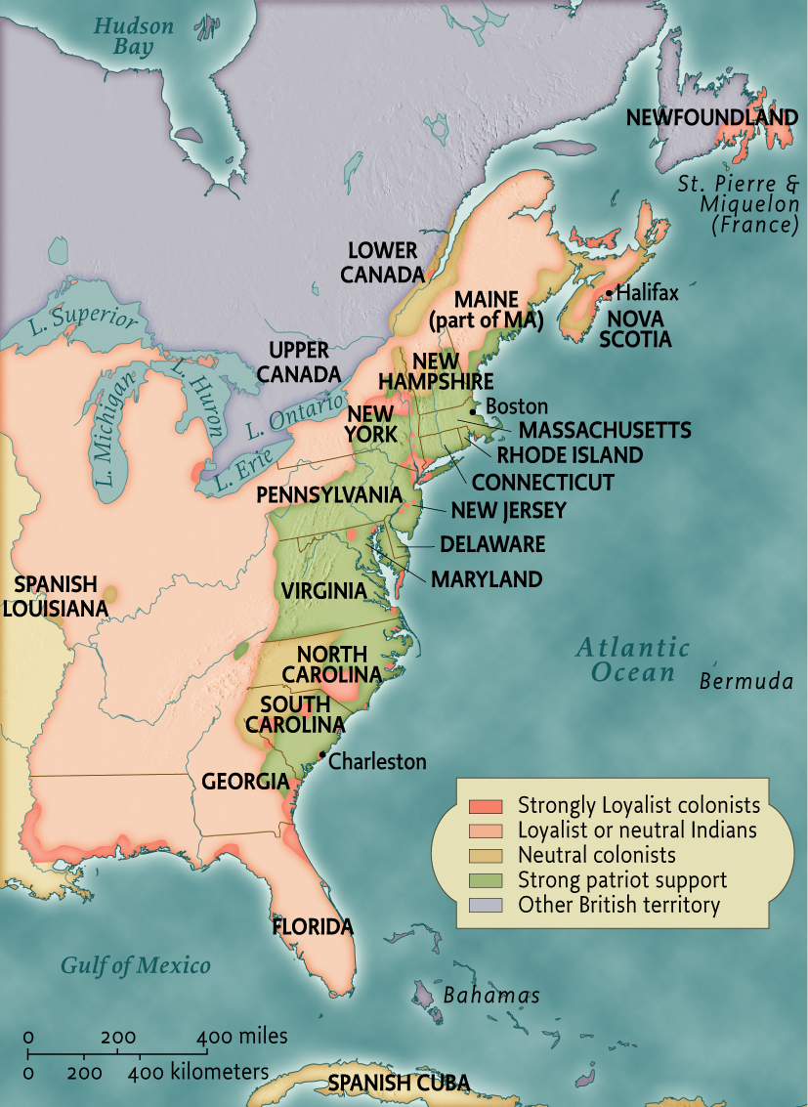
Loyalism in the American Revolution • pg. 216
Loyalism in the
American Revolution

Slide 25
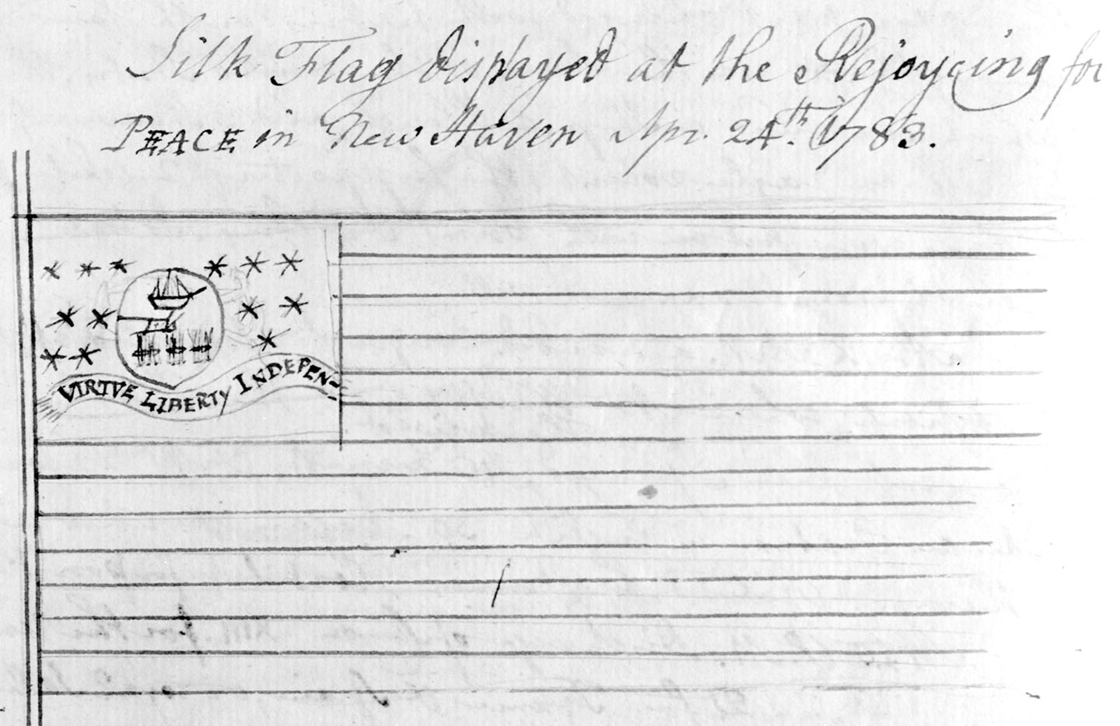
fig06_07.jpg
Notes:
Page 210: Ezra Stiles, the president of Yale College, drew this sketch of a flag in his diary on April 24, 1783, shortly after Congress ratified the Treaty of Paris. Thirteen stars surround the coat of arms of Pennsylvania. The text illustrates the linkage between virtue, liberty, and American independence.
Credit: Courtesy of the Beinecke Rare Book and Manuscript Library, Yale University.

Slide 26
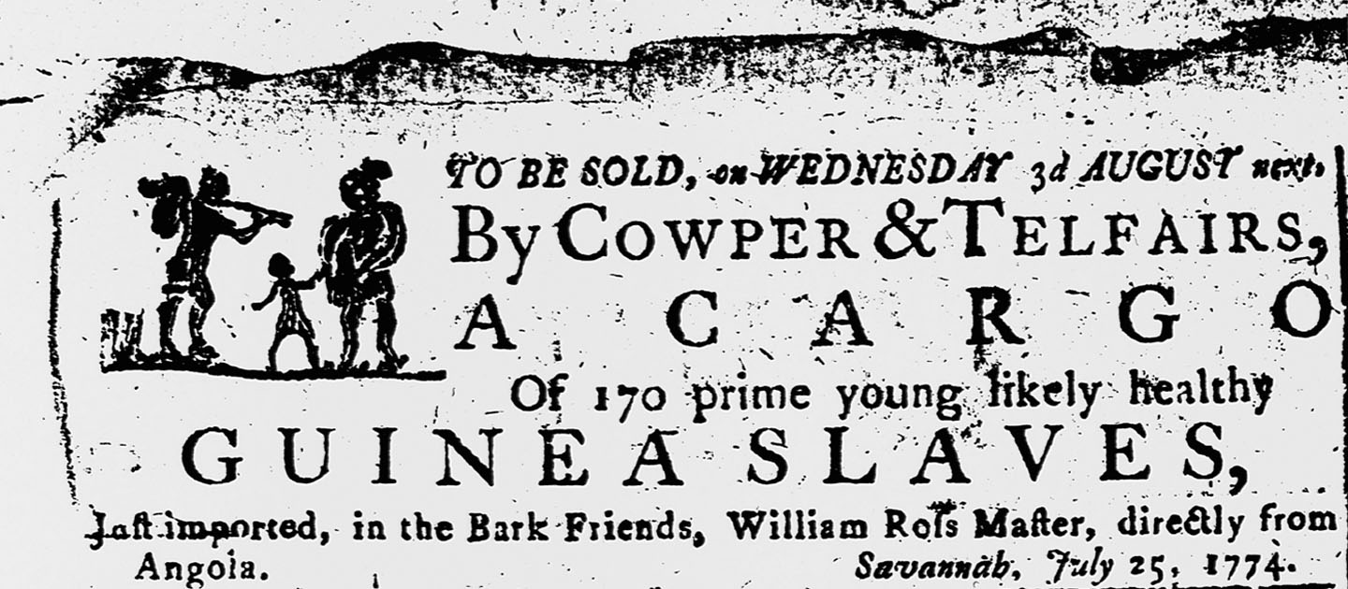
fig06_12.jpg
Notes:
Page 221: Advertisement for newly-arrived slaves, in a Savannah newspaper, 1774. Even as colonists defended their own liberty against the British, the buying and selling of slaves continued.
Credit: Corbis.

Slide 27
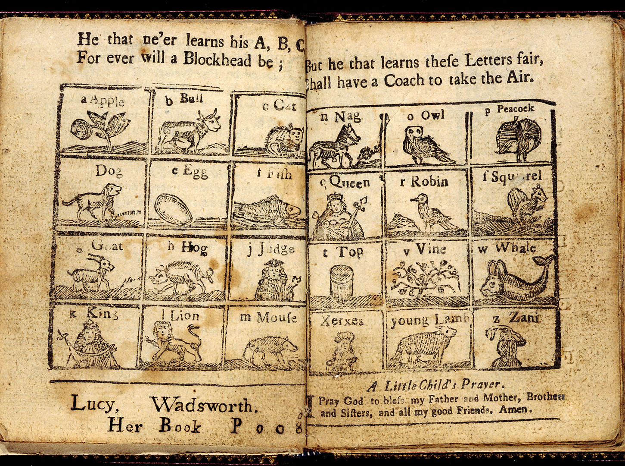
fig06_17.jpg
Notes:
Page 230: Two pages from the New England Primer Enlarged (1779), teaching the alphabet to young children while warning of the consequences of illiteracy. Schoolbooks of the era emphasized both learning and virtuous behavior.
Credit: Library of Congress: Rare Books and Special Collections Division LC-USZC4-5313.

Slide 28
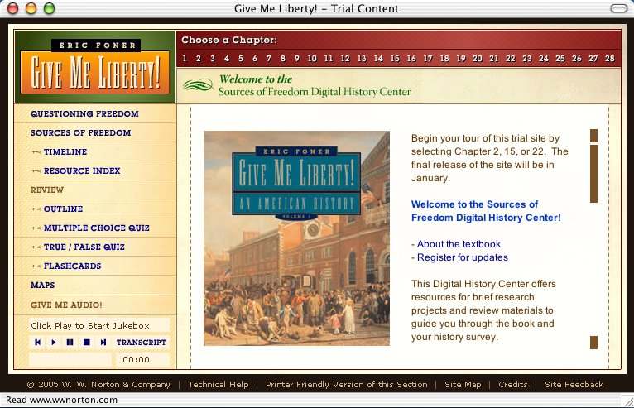
Go to website
http://www.wwnorton.com/foner/

Slide 29
End chap. 6
This concludes the Norton Media Library
Slide Set for Chapter 6
Give Me Liberty!
An American History
by
Eric Foner
W. W. Norton & Company
Independent and Employee-Owned

